Slide 1

Final Presentation
Team 2 - AtomiX

Slide 2
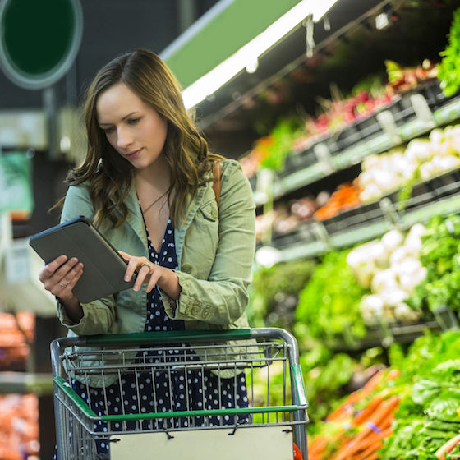
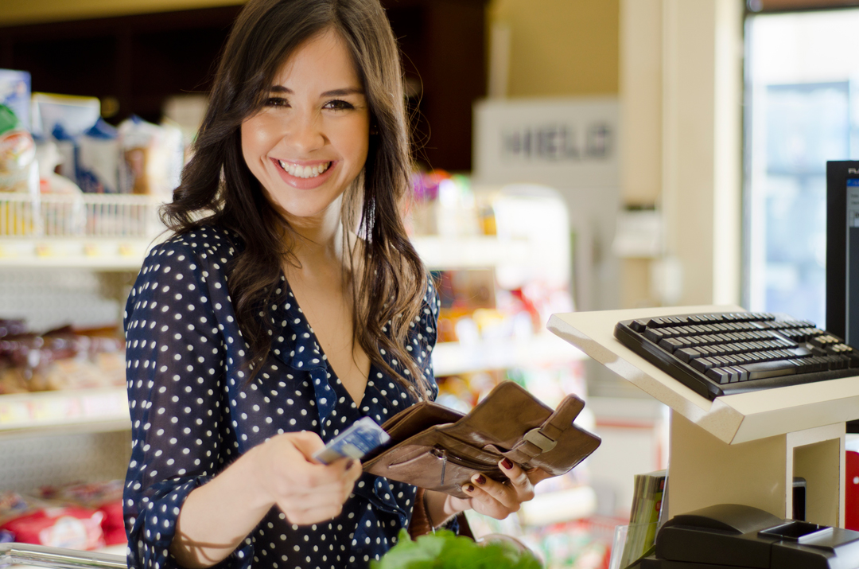


What was our objective?
Usable App
Manage money
Correct amount and correct change
More options
Notes:
Restatement of the project problem
What was the aim?

Slide 3
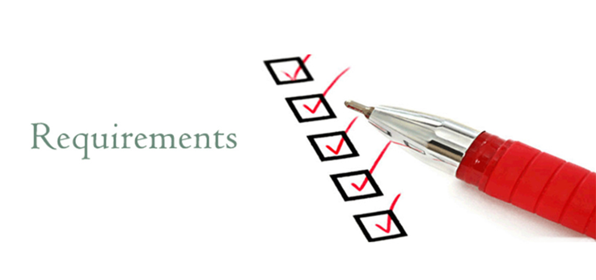
How did we know what to include in this app?
Notes:
By identifying the user requirements.
How did we identify these requirements?
Client meetings
Client question documents
Scenarios and use cases

Slide 4

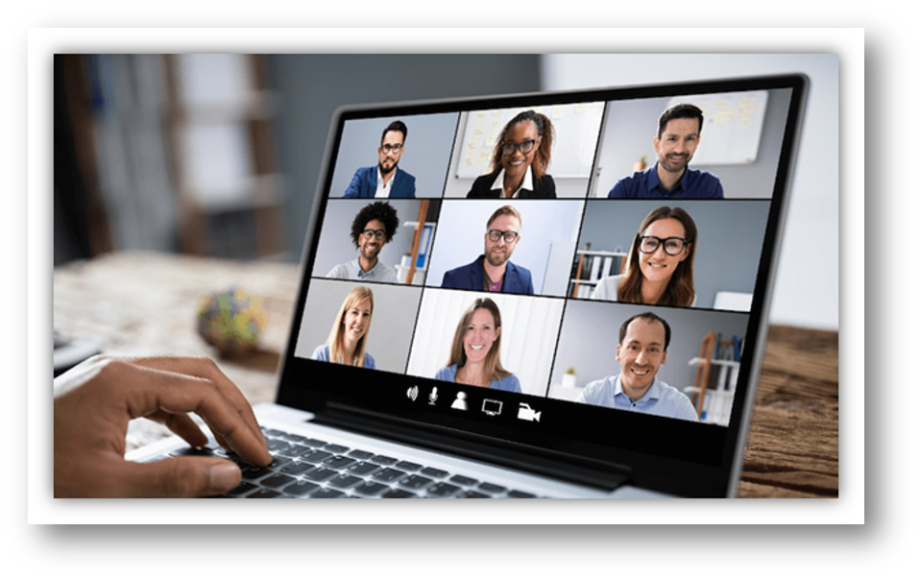
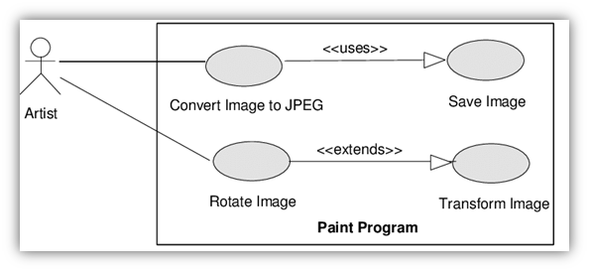
How did we Identify these requirements?
Client Meetings
Question Documents
Use case Scenario's
Notes:
Describe requirements
Use case description
Describe features

Slide 5
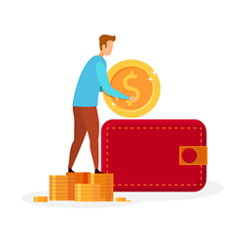



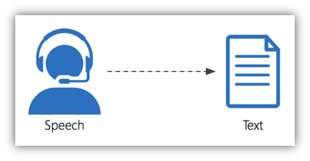


Insert money
Pay
Change
What were the Requirements?
Scan
Virtual Money

Slide 6
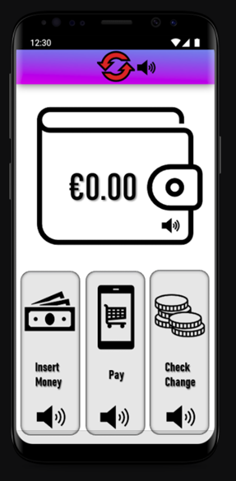
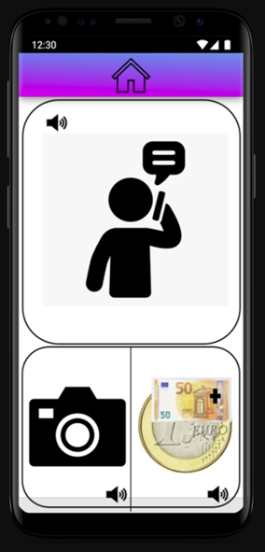
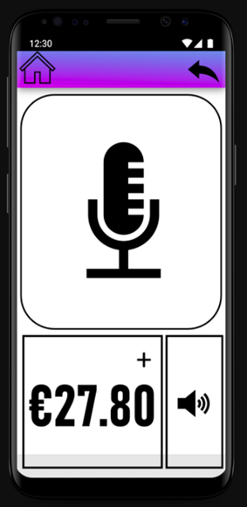
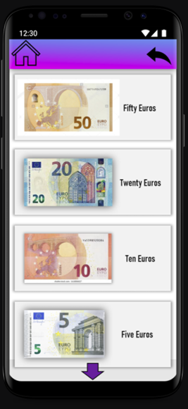
Design Recap
Notes:
Brief Recap
Show pictures of design

Slide 7


Implementation
Were we successful?

Slide 8



The Main Issues..
Camera
Microphone
Money List

Slide 9

Our Testing Phase
Microphone : unit test
Clickable Money 1 : black box test
Clickable Money 2 : performance test
Camera : unit test, user acceptance test
Design : user acceptance test
Voice Recording : user acceptance test, unit test

Slide 10



Our Experience with Clients
Benefits
Communication
Identify problems
Challenges
No face-to-face meetings
What worked the best?!
Contribution and feedback

Slide 11
Our Conclusions from this Project

Slide 12


Challenges we Faced..
Implementation
Camera feature
Linking wallet to features
Check Change feature
Limited Knowledge
Unfamiliar elements (text-to-speech/camera recognition/ API's)
Personal research emphasized

Slide 13


Benefits/Challenges of Team Working
Benefits
Facilitates creativity ​
Improves productivity​
Learn faster
Challenges
Low engagement​
Working on our own

Slide 14

Did the team charter help?
Yes!
Used for guidance
To keep track of workload
To highlight key dates
Identify our goals
Recognise groups objectives and results

Slide 15

Questions That Arise
Would we do it again?
Definitely – Experience, Teamwork, Customer Interaction
How those this benefit us?
Professional Career – CV, Customer Interaction
Improvement in – Mediation, Attentiveness, IT Skills
Are we happy with the end results?
Very Proud
​Happy Team, Happy Lecturers, Happy Customers!

Slide 16





What Would We Change/Implement?
Design of Safe Spend
Cleaner UI – Slicker desgin overall, with a better colour contrast
Design of Features?
Cleaner design
Better check change feature
Localization – Irish, German, French
Map Interface
Would record where the user was
​Log information into a system

Slide 17




What We Learned Making SafeSpend?
Importance of Accessibility
How people percieve text and elements
Different users, blind, deaf, visually impaired
Customer Feedback
Customer Interaction – Feedback, Lessons. Listening
Better representation of elements and images
Importance of Teamwork
Communication, Sharing Ideas, Problem Solving
​Teamwork, makes the dream work!

